Slide 1
Convolutional Neural Networks (CNNs) for Beginners
History, How CNN’s work, Starter Code
Presenter: Edward Preble, RTI International
DOG
CAT

Slide 2
Sooooo complicated…. do I REALLY need to care???
YES

Slide 3
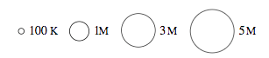
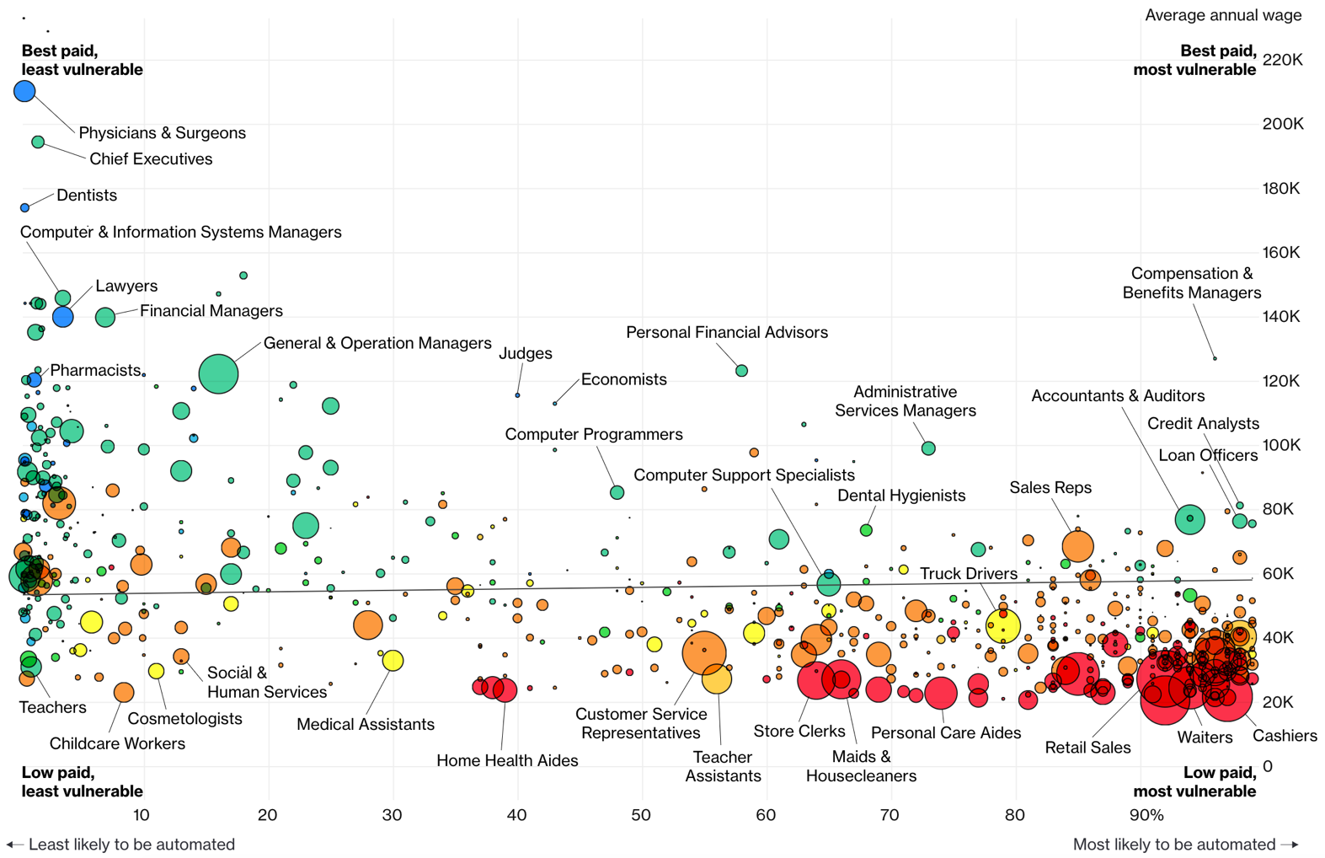
Jobs likely to be displaced by automation (esp. Neural Networks)
Bloomberg 7/2017

Slide 4
Lecture Agenda
Intro
Why CNNs are suddenly capable of automating so many jobs
History of CNN advances
How CNNs work
Tensorflow Playground CNN Demo
Object recognition training using open source Python code
Object Classification (Tensorflow for Poets Demo)
Cautionary notes
Intro
History
Demo
Model
Caution
Wrap Up

Slide 5
Intro
Edward Preble (LinkedIn, Github)
Data Scientist at RTI International, Raleigh
Background
Physics (Materials Science, PhD)
Semiconductor/Electronics industry
NCSU Data Science, Institute for Advanced Analytics (MS)
Wilmington Ties
Several internships at GE Nuclear (California, Wilmington)
Data science practicum project with Live Oak
Intro
History
Demo
Model
Caution
Wrap Up

Slide 6
Lecture Agenda
Intro
Why CNNs are suddenly capable of automating so many jobs
History of CNN advances
How CNNs work
Tensorflow Playground CNN Demo
Object recognition training using open source Python code
Object Classification (Tensorflow for Poets Demo)
Cautionary notes
Intro
History
Demo
Model
Caution
Wrap Up

Slide 7
Neural network perfect storm has arrived
Viable NN Products Need:
Availability of Training Data
Complex Models (deep networks)
Hardware (GPUs)
ImageNet Competition Winning Model
Intro
History
Applications
Training
Caution
Wrap Up
Notes:
Data wise, to train a CNN to identify a complex object, one needs ~10,000 diverse examples of the object
A computer can’t tell a dog and a cat apart with just a few variables
If you have a ton of data, and a very complex model, you need fast computing. Introduction of GPU usage for these calculations was key.

Slide 8
CNN Applications Today
Image and video recognition
Self-driving cars
Recommender systems
YouTube recommendations
Voice-to-text and translation
Siri
Google translate
Intro
History
Applications
Training
Caution
Wrap Up

Slide 9
CNN Applications Being Developed
Healthcare
More advanced voice recognition systems
Finance
ARIMA - Time series with seasonal components
VAR (Vector Auto-Regressive) – More predictor variable types
CNNs – Adds more non-linear response capability
LSTM / RNNs – Recurrent Neural Networks handle time/memory
Intro
History
Applications
Training
Caution
Wrap Up

Slide 10
Lecture Agenda
Intro
Why CNNs are suddenly capable of automating so many jobs
History of CNN advances
How CNNs work
Tensorflow Playground CNN Demo
Object recognition training using open source Python code
Object Classification (Tensorflow for Poets Demo)
Cautionary notes
Intro
History
Demo
Model
Caution
Wrap Up

Slide 11
What is a CNN?
Network
Interconnected things, sometimes in complex ways
Neural Network
“Neural” because it’s modelled (simplistically) on the human brain
Convolutional Neural Network
Combine 2+ math functions into 1
Convolution “layers” act as “detectors” for certain features
Intro
History
Demo
Model
Caution
Wrap Up

Slide 12
CNN Diagram for Image Analysis
All Image Pixels
Edges/Curves
Eyes/Nose
Dog
Input Data
Input Layers
Detection Filters
Simple Features
Detection Filters
Complex Features
Classification
Inception v3
(Google CNN Architecture)
Intro
History
Demo
Model
Caution
Wrap Up

Slide 13
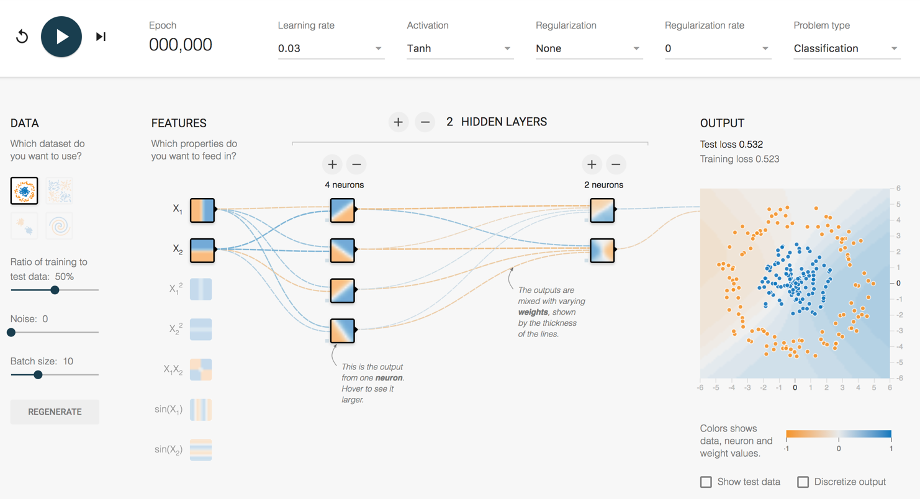
How does it work?
http://playground.tensorflow.org/
Intro
History
Demo
Model
Caution
Wrap Up
Notes:
Look at random initial weights
Single click advance the model on the vertical feature only
Watch weights increase
Division gets clearer
Test loss gets lower and lower
Reset – show learning rate effect
Single click advance the model on the horizontal feature only
Single click advance the model on the vertical + horizontal
Show next 3 features that they don’t work
Do all 5 together
Weights that increase are said to be ACTIVATED

Slide 14
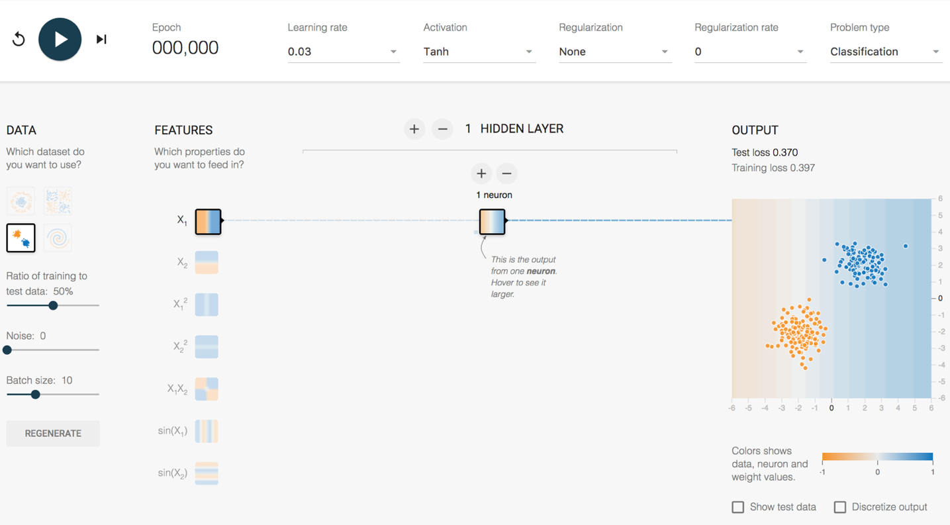
Playground Demo 1
2 Clumps 1 Feature 1 Hidden Layer
1 Neuron
Intro
History
Demo
Model
Caution
Wrap Up
Notes:
Look at random initial weights
Single click advance the model on the vertical feature only
Watch weights increase
Division gets clearer
Test loss gets lower and lower
Reset – show learning rate effect
Single click advance the model on the horizontal feature only
Single click advance the model on the vertical + horizontal
Show next 3 features that they don’t work
Do all 5 together
Weights that increase are said to be ACTIVATED

Slide 15
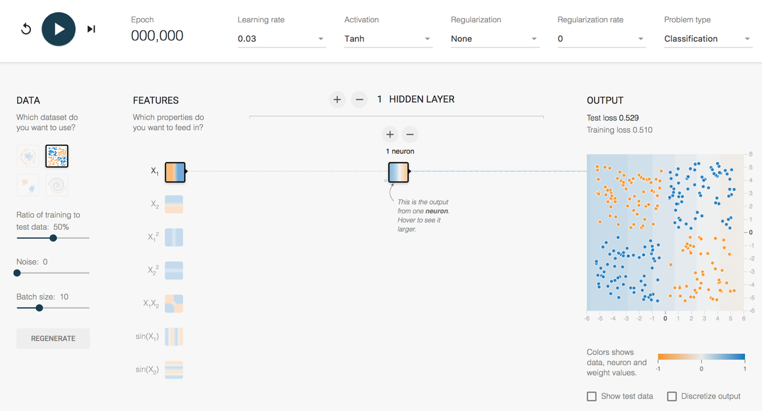
Playground Demo 2
4 Clumps 1 Feature 1 Hidden Layer
1 Neuron
Intro
History
Demo
Model
Caution
Wrap Up
Notes:
1 feature, 1 layer, 1 neuron – terrible
2 feature, 1 layer, 1 neuron – now get an angle, better
Lets add a second layer
2 feature, 2 layer, 1/1 neuron – Makes no sense to have single neuron into single neuron, can reverse info, but can’t adjust it
Add second neuron to layer 1
2 feature, 2 layer, 2/1 neuron – Sometimes single line, like above. Sometimes more of a “corner”, sometimes makes a valley (best)
Hover over neurons and weights for each neuron to show how it adds up
What is the best way to make this work? Use the feature that fits the data better
1 x1x2 feature, 1 layer, 1 neuron
With small networks of the past, feature engineering was where everyone worked to make this stuff happen. Good features = Good model. Bad features = no luck.
But, what is the magic feature to tell a cat apart from a dog?

Slide 16
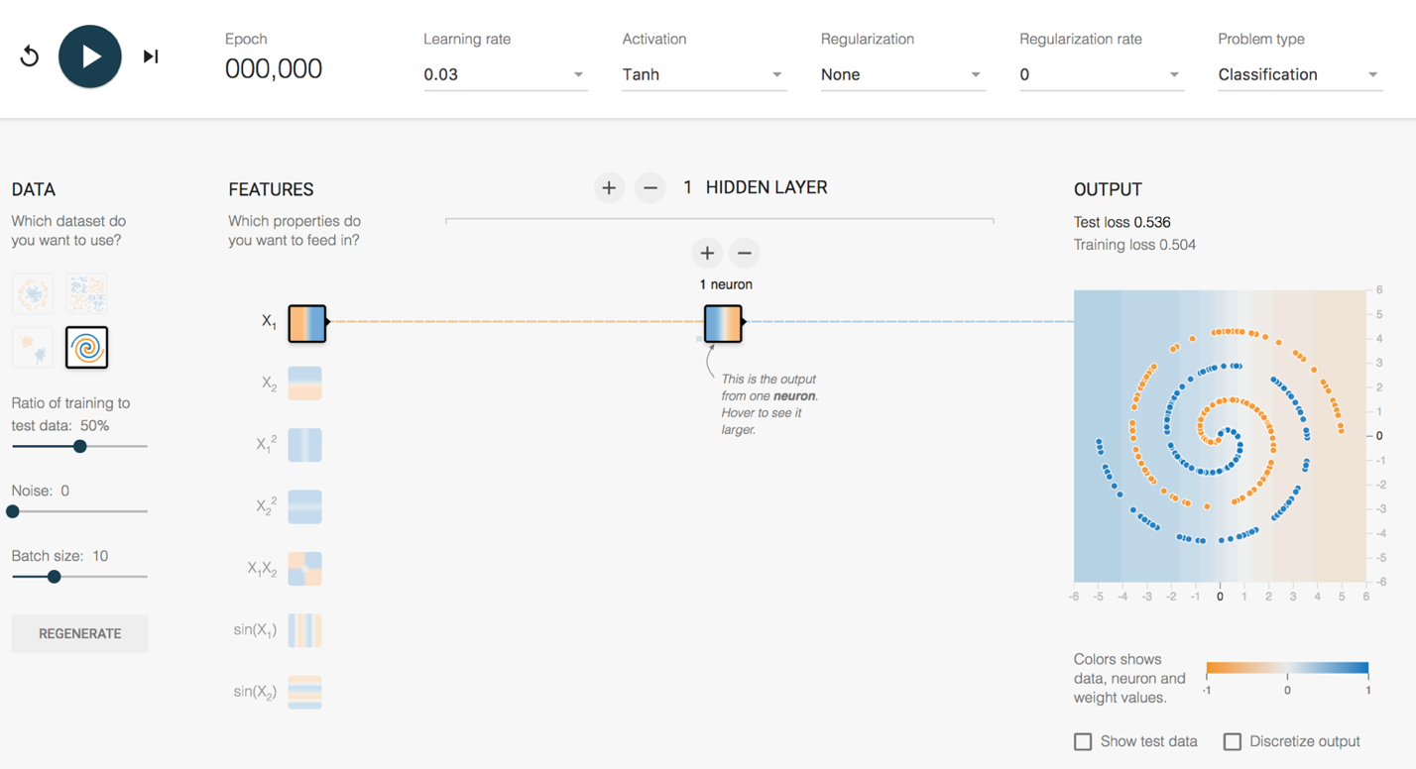
Playground Demo 3
Spiral 1 Feature 1 Hidden Layer
1 Neuron
Intro
History
Demo
Model
Caution
Wrap Up
Notes:
More complex Shape – Spiral
1 feature, 1 layer, 1 neuron – terrible
All features, - starts making dots
All features , 1 layer, 2 neurons
All features – Keep trying until a semblance of a spiral
All features , 2 layers, 2 neurons, spirals lots of other stuff
All features , 5 layers, top layers are washed out. No new information being generated.
All features , 5 layers, 5/4/3/2/1, might get it
6 layers, 7/6/5/4/3/2, starts working pretty well pretty quickly – weird looking, but works

Slide 17
How does a CNN “Learn”?
Backpropagation
Initial network settings are random
Test prediction using training data
Adjust network by a certain amount (Learning Rate) to reduce the error
Start at the end of the network and work backwards
?
Dog
Dog
Dog
?
Cat
Cat
Cat
?
?
Intro
History
Demo
Model
Caution
Wrap Up

Slide 18
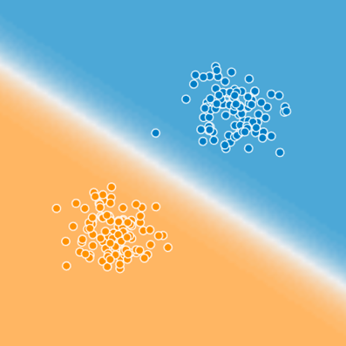
Is that it?
Blue
Cat
Typing
on a
Laptop
in the
Kitchen
How to get to here?
Orange
Intro
History
Demo
Model
Caution
Wrap Up

Slide 19
How complex are these models?
All Image Pixels
Edges/Curves
Eyes/Nose
Dog
Input Data
Input Layers
Detection Filter
Simple Features
Detection Filter
Complex Features
Classification
Inception v3
(Google CNN Architecture)
Number of Parameters = 23,200,000
Number of Layers = 48
Intro
History
Demo
Model
Caution
Wrap Up
Notes:
Back to the structure of the CNN, and how these layers start really working for complex images.
For an image, the input layers, instead of being data points like the playground example, they will be the actual pixel values for the image. The last model I used at RTI had 704x704 pixel input images, with 3 colors (RGB), which translates into ~1.5M input neurons.
So, you feed this image into the network, certain neurons and features will “activate”, which will then output at the end, is it blue or orange? Is it a cat or a dog?
On Inception v3, the number of layers is 48, the number of parameters is ~23M, the number of multiply/add calculations per sweep is ~5B.
This is DEEP LEARNING. There is a ton going on under the hood.

Slide 20
Lecture Agenda
Intro
Why CNNs are suddenly capable of automating so many jobs
History of CNN advances
How CNNs work
Tensorflow Playground CNN Demo
Object recognition training using open source Python code
Object Classification (Tensorflow for Poets Demo)
Cautionary notes
Intro
History
Demo
Model
Caution
Wrap Up

Slide 21
Object Classification
Great Image Classification Demo + Code from Google: https://codelabs.developers.google.com/codelabs/tensorflow-for-poets Use python 3.6, NOT the latest default python 3.7
Jupyter Notebook to use with your photos on GitHub in “tensorflow-for-poets-2” directory git clone https://github.com/epreble/port_city_analytics_meetup pip install jupyter jupyter notebook
Intro
CNN Details
Applications
Training
Caution
Wrap Up

Slide 22
Thanks!

Slide 23
Lecture Agenda
Intro
Why CNNs are suddenly capable of automating so many jobs
History of CNN advances
How CNNs work
Tensorflow Playground CNN Demo
Object recognition training using open source Python code
Object Classification (Tensorflow for Poets Demo)
Cautionary notes
Intro
CNN Details
Applications
Training
Caution
Wrap Up

Slide 24
Gartner Hype Cycle for 2017
Intro
CNN Details
Applications
Training
Caution
Wrap Up

Slide 25
Model Bias
What if a flower classification model is better at roses than tulips?
What if a facial recognition model is better at Caucasian than African American faces?
How might that impact real people, not just marketing or profit margins?
Don’t ignore the ethics of how a model might be applied. Make those discussions happen.
Intro
CNN Details
Applications
Training
Caution
Wrap Up

Slide 26
Resources to Learn More
Entry Level Videos:
Josh Gordon (Google) Machine Learning Tutorials https://www.youtube.com/watch?v=cKxRvEZd3Mw
Siraj Raval - Various Artificial Intelligence Videos https://www.youtube.com/channel/UCWN3xxRkmTPmbKwht9FuE5A
More Advanced
Adrian Rosebrock (Lots of Python and OpenCV Materials) https://www.pyimagesearch.com/
Geoffrey Hinton’s Coursera Class https://www.coursera.org/learn/neural-networks
Intro
CNN Details
Applications
Training
Caution
Wrap Up

